Slide 1

Designing Arithmetic Logic Units (ALU) Using Turing Machine Principles
This presentation explores the design of Arithmetic Logic Units (ALUs) using principles derived from Turing Machines. This approach offers a unique perspective on hardware design, emphasizing computational steps and providing a framework for understanding and implementing complex arithmetic operations.
BY RISSHITH(192210021)
S.PRAKUL(192210073)

Slide 2

Introduction to Turing Machines
1
Theoretical Model
2
Universal Computation
A Turing machine is a theoretical model of computation that consists of a tape, a head, and a set of states.
Turing Machines are capable of simulating any algorithm, making them a powerful tool for understanding the limits of computation.
3
Fundamental Concepts
The core concepts of Turing Machines, including states, transitions, and tape manipulation, form the basis for our ALU design.

Slide 3
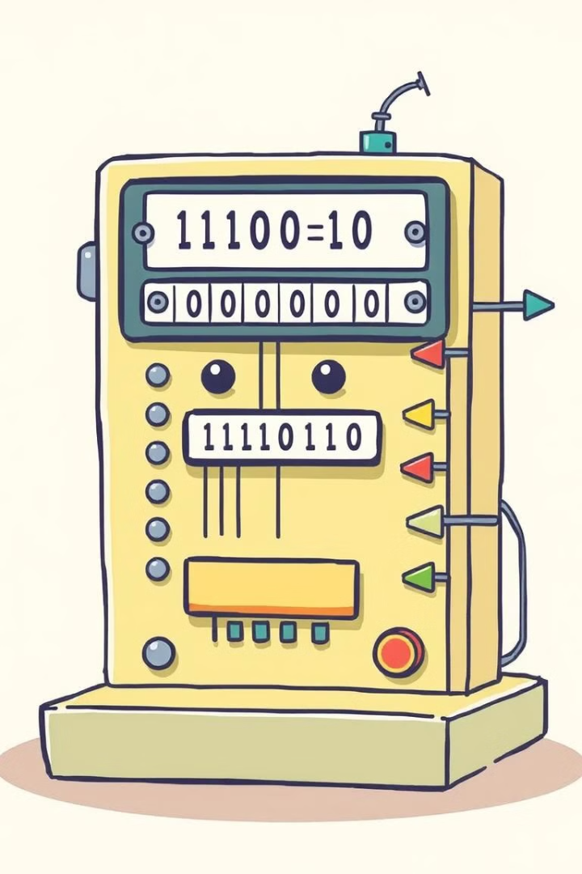
Principles of Turing Machine Computation
1
State Transitions
Turing Machines operate by transitioning between states based on the current state and the symbol read from the tape.
2
Tape Manipulation
The head can read and write symbols on the tape, moving left or right as dictated by the transition function.
3
Halting Condition
Turing machines halt when they reach a specific halting state, indicating the completion of the computation.

Slide 4
Applying Turing Machine Concepts to ALU Design
State Register
Data Register
Control Unit
The ALU's state register corresponds to the Turing Machine's current state, guiding the computational process.
The data register acts as the Turing Machine's tape, storing the input and intermediate results of operations.
The control unit implements the Turing Machine's transition function, determining the next state based on the current state and data.

Slide 5
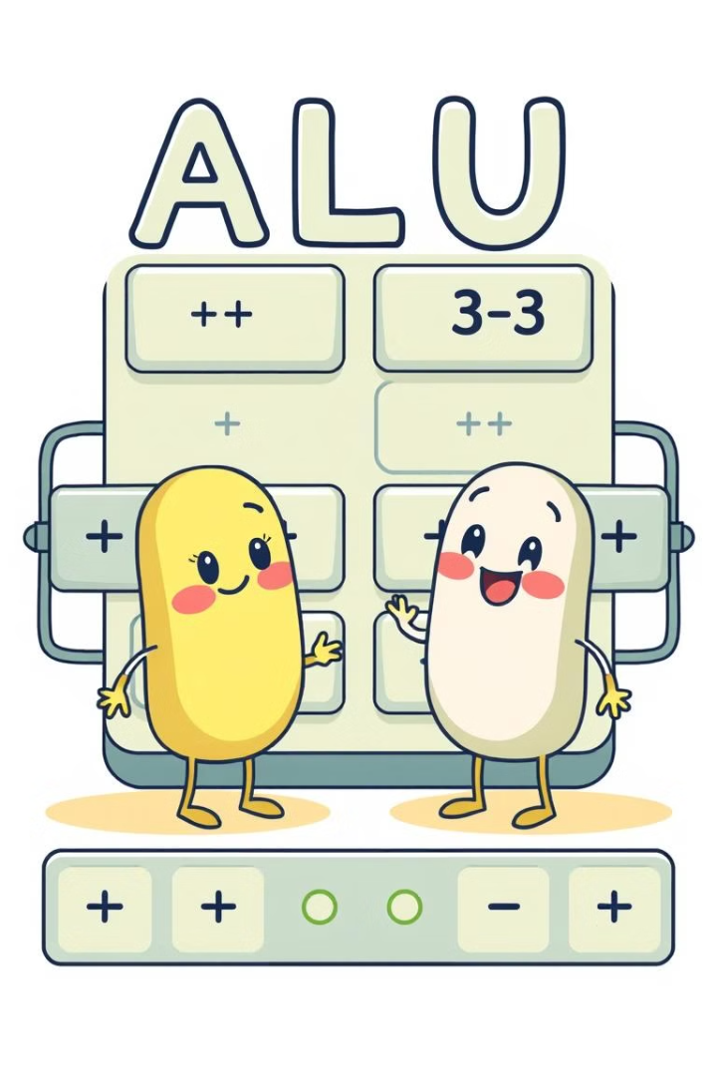



Implementing Addition and Subtraction in the ALU
Addition
Addition is implemented using a sequence of full adders, processing bits from the input operands and carrying over any overflows.
Subtraction
Subtraction is implemented using two's complement arithmetic, converting the subtrahend to its complement and adding it to the minuend.
Output
The result of the addition or subtraction operation is stored in the data register for further processing.

Slide 6
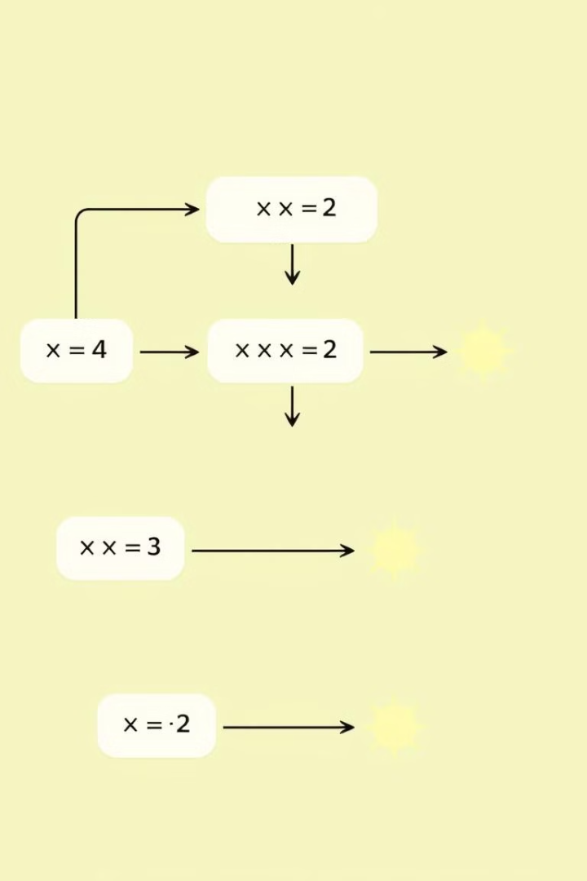
Implementing Multiplication and Division in the ALU
Multiplication
Repeated addition
Shifting and adding the multiplicand based on the multiplier's bits.
Division
Repeated subtraction
Subtracting the divisor from the dividend until the remainder is less than the divisor, counting the subtractions as the quotient.

Slide 7




Handling Overflow and Underflow Conditions
Overflow Flag
Underflow Flag
Error Handling
A flag is set to indicate an overflow condition, where the result exceeds the capacity of the data register.
A flag is set to indicate an underflow condition, where the result falls below the minimum representable value.
Appropriate error handling mechanisms are implemented to handle overflow and underflow situations, preventing unexpected behavior.

Slide 8

Advantages of the Turing Machine-based ALU
Conceptual Clarity
Modular Design
This approach offers a clear understanding of the computational steps involved in arithmetic operations, providing insights into the inner workings of the ALU.
The modular nature of Turing Machine principles allows for the development of easily adaptable and extensible ALU designs.
Efficiency
This approach can lead to efficient designs, minimizing resource usage and maximizing performance.

Slide 9

Conclusion and Future Directions
This approach offers a novel way to design ALUs, leveraging the power of Turing Machines to provide clarity, modularity, and efficiency. Future research can explore the application of this design methodology to more complex arithmetic and logical operations, expanding the capabilities of hardware computation.

